Slide 1

OS L31
Directory Structure
Directory implementation
Presented by:
Veena K M
OS Teacher for IV IT A
9845714070
veena.gv@manipal.edu

Slide 2
9.3 Directory and Disk Structure
A directory is a container that is used to contain folders and files
Disk can be subdivided into partitions
Partitions also known as minidisks, slices (c: drive, d: drive etc…)
Entity containing file system (FAT, NTFS) known as a volume
Each volume containing file system also tracks that file system’s information in device directory or volume table of contents
The device directory records information—such as name, location, size, and type—for all files on that volume.

Slide 3
9.3 Directory and Disk Structure
Directory Overview
Possible operations on directory are:
Search for a file
Create a file
Delete a file
List a directory
Rename a file
Traverse the file system
Notes:
Renaming a file may also allow its position within the directory structure to be changed.
Traverse: access every directory and every file within a directory structure

Slide 4
9.3 Directory and Disk Structure
Directory Organization
The directory is organized logically to obtain
Efficiency – locating a file quickly
Naming – convenient to users
Two users can have same name for different files
The same file can have several different names
Grouping – logical grouping of files by properties, (e.g., all Java programs, all games, …)

Slide 5
9.3 Directory and Disk Structure
Directory Organization
Common schemes for defining the logical structure of a directory are:
Single-Level Directory
Two-Level Directory
Tree-Structured Directories
Acyclic-Graph Directories
General Graph Directory

Slide 6
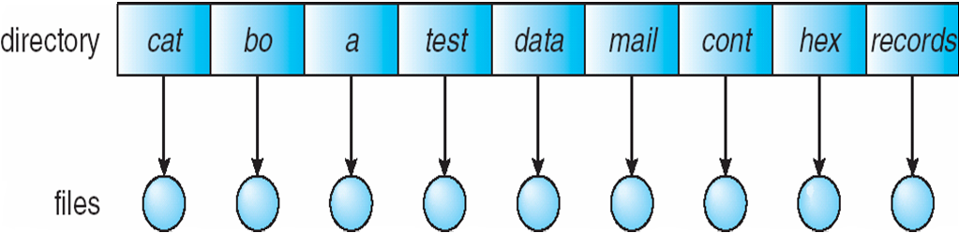
9.3 Directory and Disk Structure
Directory Organization
1. Single-Level Directory
The simplest directory structure
All files are contained in the same directory, which is easy to support and understand
All files must have unique names
Poorly organized
Shared among all the users

Slide 7
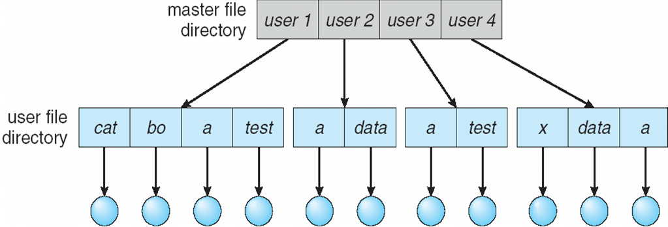
9.3 Directory and Disk Structure
Directory Organization
2. Two-Level Directory
Separate directory for each user
Different users may use same file name (solves the name-collision problem)
Efficient searching
Good when user perform independent tasks
Inefficient if users want to share their work in order to perform dependent tasks

Slide 8
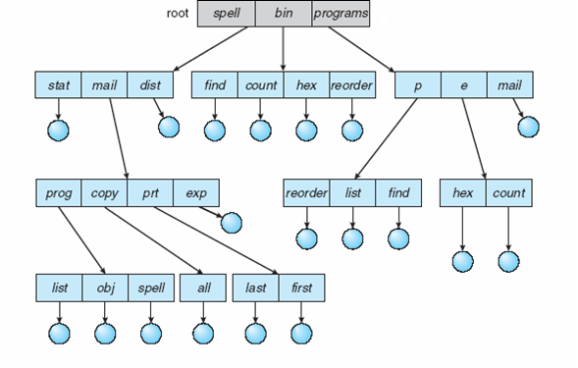
9.3 Directory and Disk Structure
Directory Organization
A directory is made point to rectangle using a directed edge
A file is made point to a circle using a directed edge
3. Tree-Structured Directories

Slide 9
9.3 Directory and Disk Structure
Directory Organization
3. Tree-Structured Directories (Contd…)
Provides separate directory for each user and allows users to create their own subdirectories and to organize their files accordingly
The most common and efficient directory structure
The tree has a root directory, and every file in the system has a unique path name.
All directories have the same internal format.
One bit in each directory entry defines the entry as a file (0) or as a subdirectory (1).
prohibits the sharing of files or directories

Slide 10
9.3 Directory and Disk Structure
Directory Organization
3. Tree-Structured Directories (Contd…)
Path names can be of two types: absolute and relative.
An absolute path name begins at the root and follows a path down to the specified file, giving the directory names on the path.
A relative path name defines a path from the current directory
if the current directory is root/spell/mail
then the relative path name prt/first
refers to the same file as does the absolute path name root/spell/mail/prt/first.

Slide 11
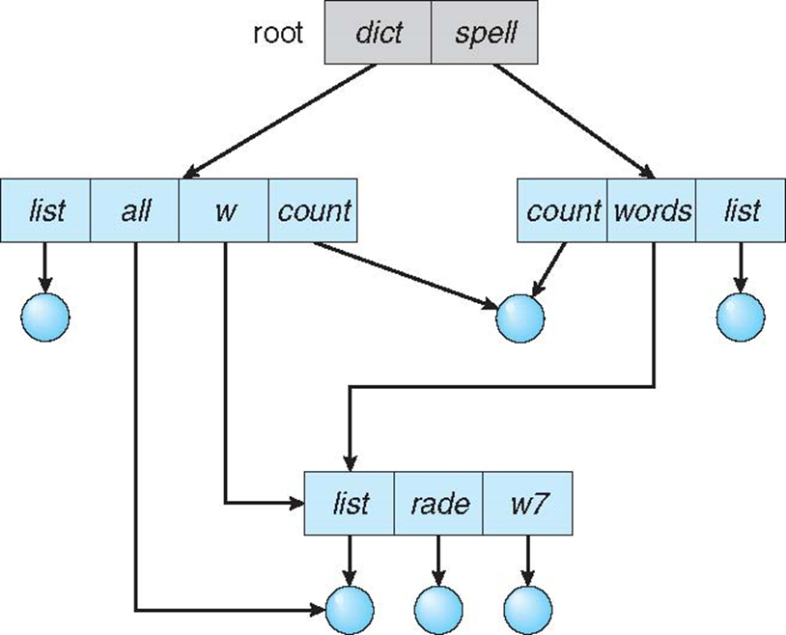

9.3 Directory and Disk Structure
Directory Organization
4. Acyclic-Graph (a graph with no cycles) Directories

Slide 12
9.3 Directory and Disk Structure
Directory Organization
4. Acyclic-Graph (a graph with no cycles) Directories (contd….)
Have shared subdirectories and files
Useful when many users work on common project
An acyclic-graph directory structure is more flexible than is a simple tree structure, but it is also more complex
The issues which need to be addressed are:
A file may now have multiple absolute path names
May result in multiple traversal of shared structures, which is inefficient
Difficult to decide when to delete the physical file (actual file) as it refer to many logical names
Must ensure that there are no cycles whenever a shared directory is created

Slide 13
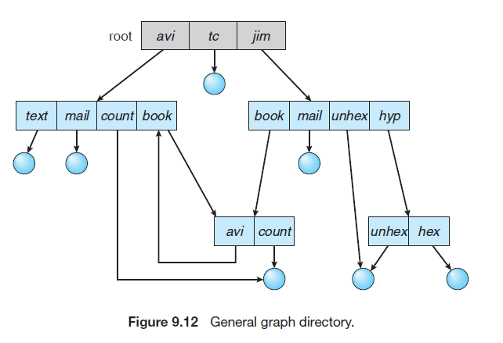

9.3 Directory and Disk Structure
Directory Organization
5. General Graph Directory

Slide 14
9.3 Directory and Disk Structure
Directory Organization
5. General Graph Directory (Contd…)
start with a two-level directory and allow users to create subdirectories, a tree-structured directory results.
However, when we add links (shared files/directories), the tree structure is destroyed, resulting in a simple graph structure

Slide 15
9.3 Directory and Disk Structure
Directory Organization
5. General Graph Directory (Contd…)
How do we guarantee no cycles?
Allow only links to file not subdirectories
Every time a new link is added use a cycle detection algorithm to determine whether it is OK
Garbage collection: traverse the entire file system, marking everything that can be accessed. Then, a second pass collects everything that is not marked onto a list of free space

Slide 16
10.3 Directory Implementation
1. Linear list of file names with pointer to the data blocks
Simple to program
Time-consuming to execute
Linear search time (time consuming)
Solution: Could keep ordered alphabetically via linked list or use B+ tree
To create a new file, we must first search the directory to be sure that no existing file has the same name. Then, we add a newentry at the end of the directory.
To delete a file, we search the directory for the named file and then release the space allocated to it.

Slide 17
10.3 Directory Implementation (contd..)
2. Hash Table – linear list with hash data structure
The hash table takes a value computed from the file name and returns a pointer to the file name in the linear list.
Therefore, it can greatly decrease the directory search time.
Insertion and deletion are also fairly straightforward
Collisions – situations where two file names hash to the same location
The collision resolution algorithms are not discussed as part of directory implementation topic.

